Slide 1
NGC 1560
Tannor walters

Slide 2
Traits
Spiral Galaxy
11th magnitude
Seen at an angle
Located in the Camelopardalis constellation

Slide 3
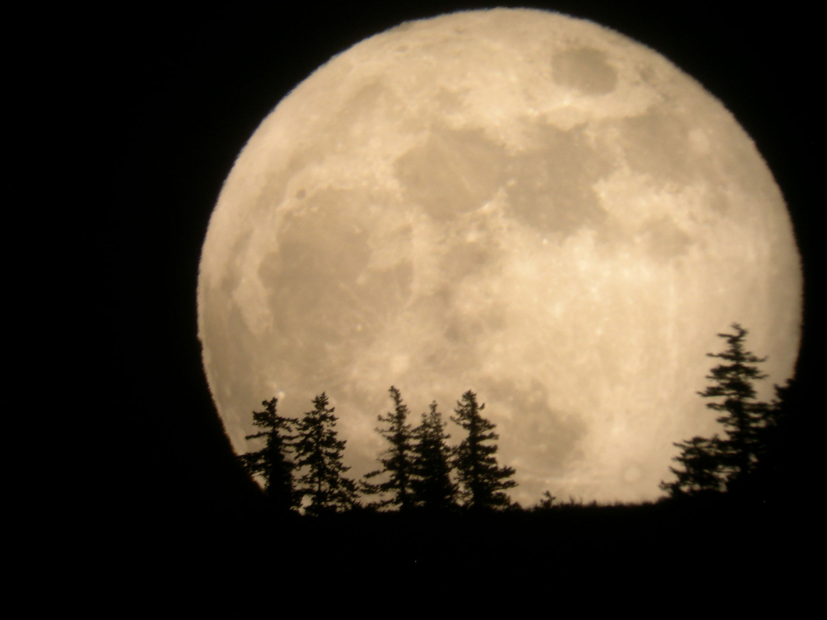
Struggles of a super moon
Images are saturated with light from the moon
Makes it difficult to find selected target and even worse for trying to get good images of target
Credit: Tim McCord

Slide 4
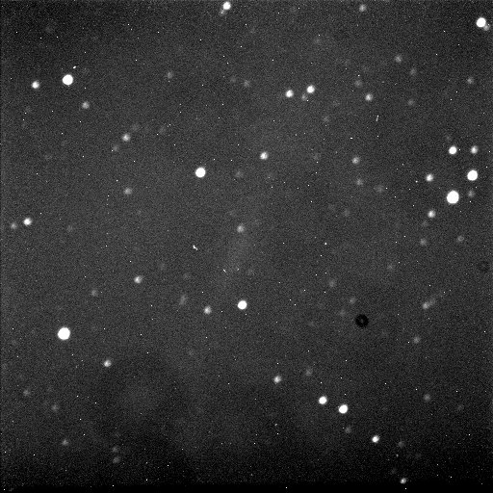
Blue filter image after data reduction

Slide 5
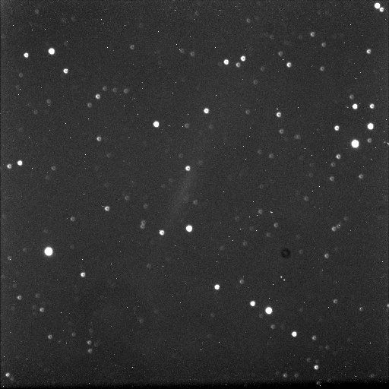
Red filter image after image reduction

Slide 6
Works cited
http://simbad.u-strasbg.fr/simbad/sim-id?Ident=NGC1560&NbIdent=1&Radius=2&Radius.unit=arcmin&submit=submit+id#lab_basic
https://dso-browser.com/deep-sky/2481/ngc-1560/galaxy
http://blog.swanastro.org.uk/2014/12/m42-with-925-sct-and-m99-m101-ngc-1514.html
http://www.space.com/15562-supermoon-photos-2012-full-moon.html

